Slide 1
PROF. A. RAMEEZA,
PG & Research Department Of Commerce (SF-W)
Jamal Mohamed College,
Trichy-20.

Slide 2
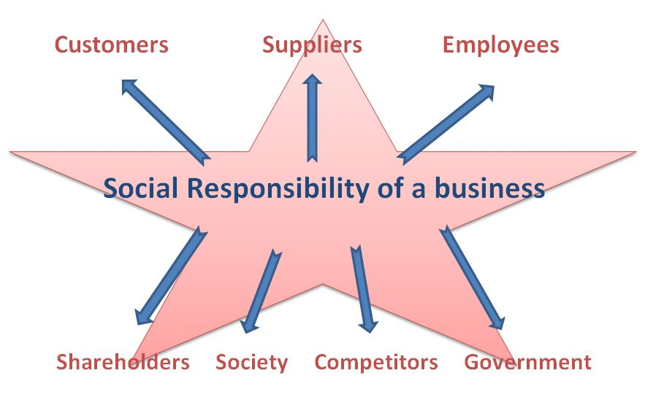

Slide 3
Social Responsibility of Business
Meaning :
The concept of social responsibility in relation to business means that the firm functions to accomplish its financial objectives and serves the society as well. No business exists in isolation. Every organ of the society contributes towards the success of a business.
Thus it becomes imperative that business too does something for the society in return. This responsibility of business towards the society is called social responsibility.

Slide 4
Definitions
“Social responsibility of business refers to the obligations of businessmen’s decisions and actions taken for reasons at least partially beyond the firm’s direct economic and technical interest.” —Keith Davis
“Social responsibility is to pursue those policies, to make those decisions, or to follow those lines of action which are desirable in terms of the objectives and values of our society.” —Howard D. Bowen

Slide 5
Need and Importance
Reason for existence
Mutual relationship
Availability of Resources
Reputation
Society’s expectations
To ensure business growth
To avoid government regulation
To solve the problems created
To benefit in the long term
To satisfy stakeholders

Slide 6
Social Responsibility of business towards various Groups
Responsibility towards Buyers ( customers)
Responsibility towards Competitors
Responsibility towards Employees
Responsibility towards Suppliers
Responsibility towards Shareholders
Responsibility towards the Government
Responsibility towards the Community

Slide 7
Arguments against corporate social Responsibility (CSR) Or Limitation
1. Milton Friedman’s argument against social responsibility
Economic Reason
Legal Reason
2. Theodore Levitt’s Argument
3. Other Argument against CSR

Slide 8


